Slide 1
Required readings
M.A. Abdou, L.J. Wittenberg, and C.W. Maynard, A Fusion Design Study of Nonmobile Blankets with Low Lithium and Tritium Inventories, Nuclear Technology, 26: 400–419 (1975).
http://www.fusion.ucla.edu/abdou/Presentation%20Web%20Page.html
Search for “Lectures in IPR, India”
Lecture 2: Solid Breeder Blanket Concepts

Slide 2
Lithium cross sections

Slide 3
Neutron multiplier cross sections

Slide 4
Some material comparisons
Properties are for 100% TD | Li2O | Li4SiO4 | Li2TiO3 | Li2ZrO3
Lithium density (g/cm3) | 0.94 | 0.51 | 0.43 | 0.38
Min-max Temp for tritium release (°C) | 397-795 | 325-925 | <900 | 400-1400
Reactivity w/ H2O | High | Little | Less | Less
Crush Load (N) | - | Low | High | High
Residence time @400°C (h) | 10 | 2 | 2 | 1

Slide 5
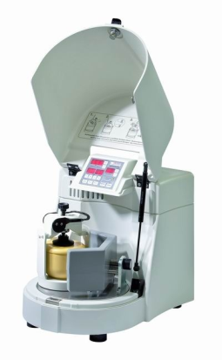
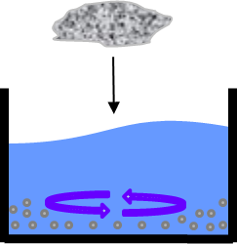
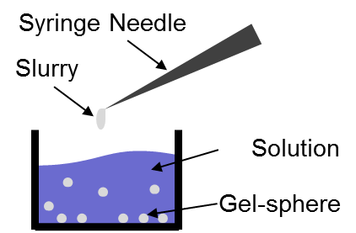
Example pebble production
Fabrication Process
Li₂TiO₃ Powder
PVA Solution
Li₂TiO₃ Powder
Mixing
Mixing
PVA Solution
Dropping into Glycerin
including Boric Acid
Shaping
Drying
Sintering
Sintering

Slide 6
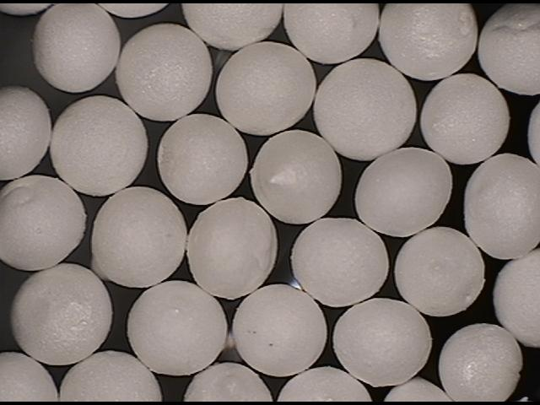
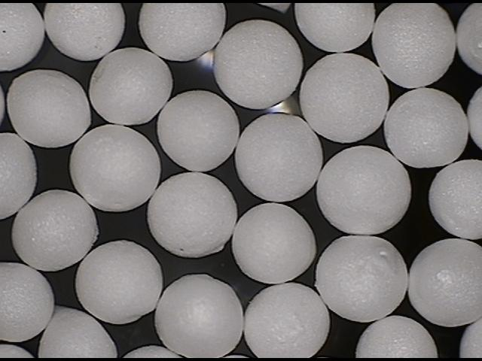
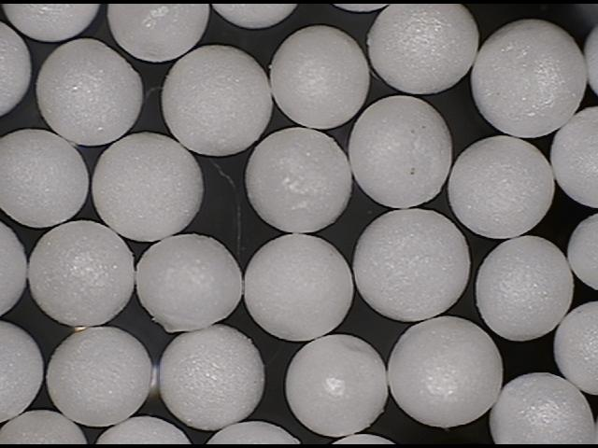
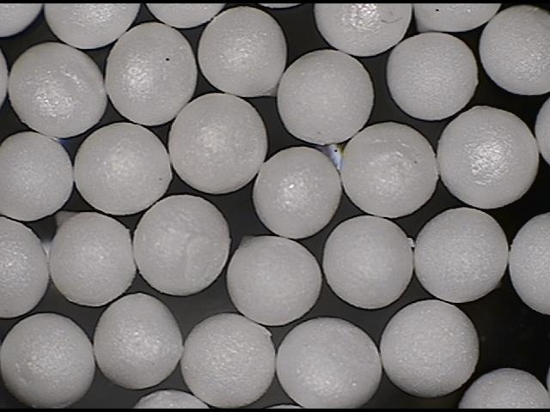
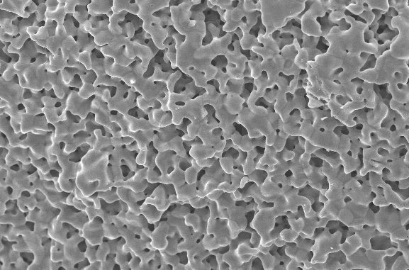
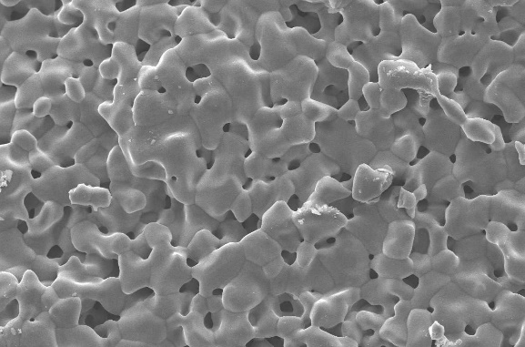
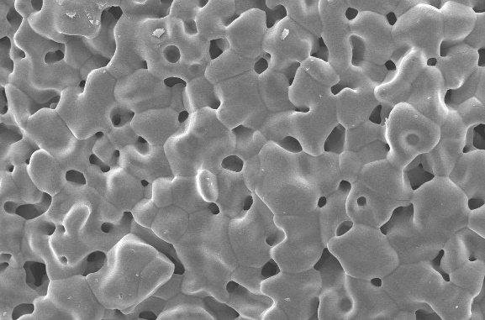
Effect of Sintering Time (1200ºC, air atmosphere)
Sintering Time : 1 h
Sintering Time : 2 h
Sintering Time : 3 h
Sintering Time : 4 h
1mm
1mm
1mm
1mm
Avg. Dia. : 1.03 mm
Avg. Dia. : 1.01 mm
Avg. Dia. : 1.00 mm
Avg. Dia. : 0.98 mm
50μm
50μm
50μm
open porosity ~ 10%

Slide 7
Sphere-sphere contact mechanics
r
a
z
P(r)

Slide 8
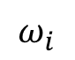
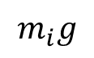
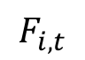
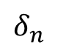
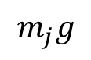
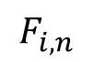
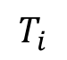
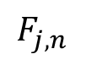
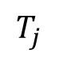
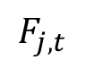
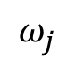
Transient Discrete Element Method
$$T_{j}$$
J
$$ω_{j}$$
$$δ_{n}$$
$$F_{j,n}$$
$$F_{j,t}$$
$$m_{j}g$$
$$T_{i}$$
Q
$$F_{i,n}$$
$$F_{i,t}$$
$$ω_{i}$$
I
$$m_{i}g$$

Slide 9
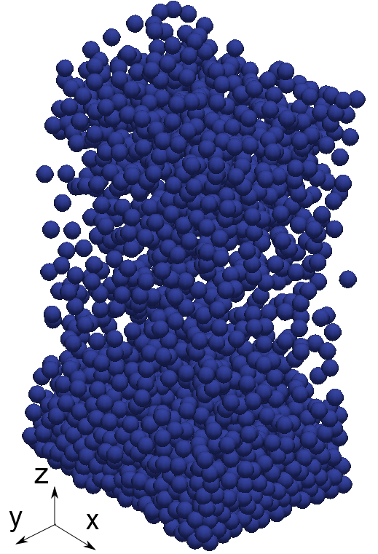
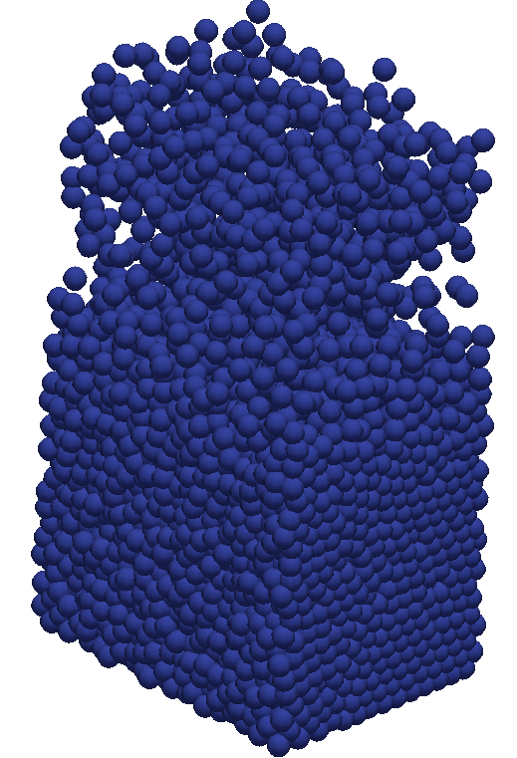
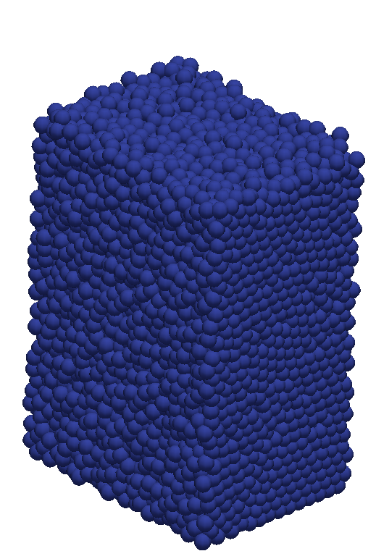
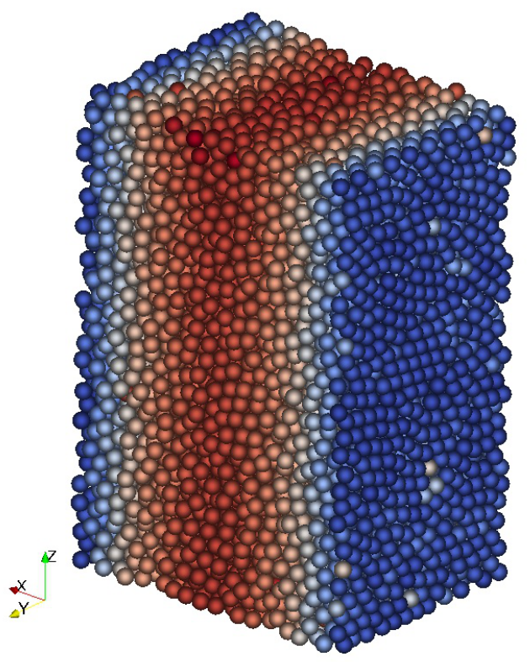
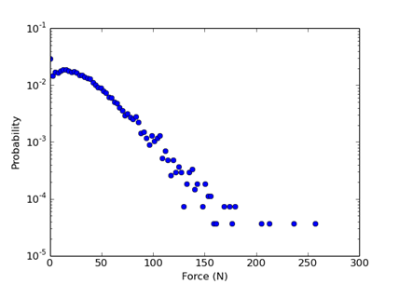
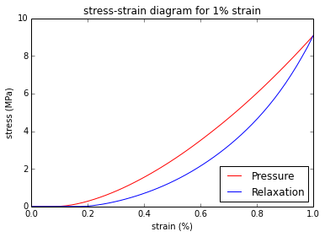
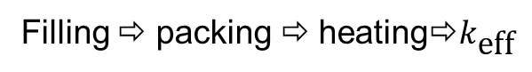
Filling ⇨ packing ⇨ heating⇨$k_{\text{eff}}$
Contact force probability distribution
Simulating oedometric compression

Slide 10
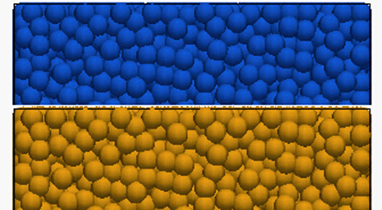
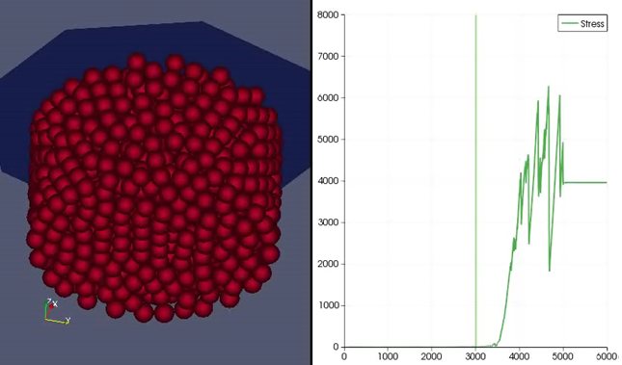

Slide 12
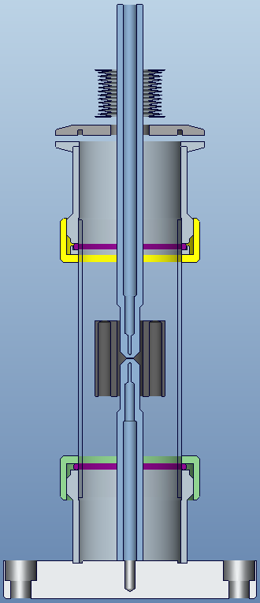
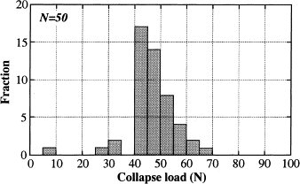
Single pebble properties
Inconel pistons
Vacuum chamber
Graphite heater
Pebble location

Slide 13
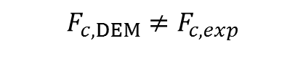
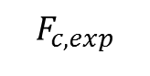
Pebble failure prediction: strain energy
$$F_{c,exp}$$
$$F_{c,DEM}≠F_{c,exp}$$
Lab tests
Ensemble

Slide 14
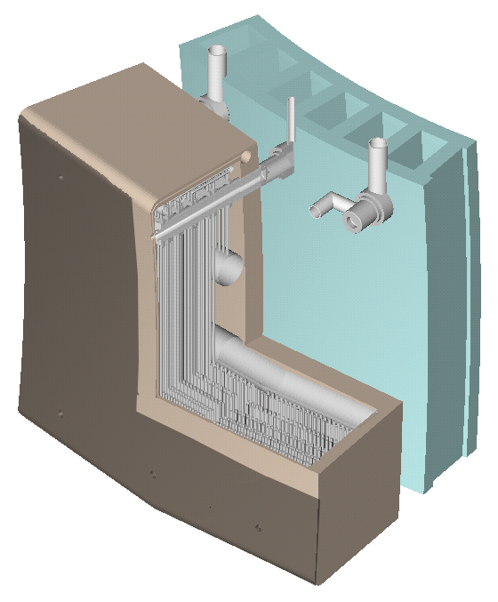
Pebble bed designs (Japanese solid breeder)
Purge gas
Coolant flow
Surface Heat Flux: 1MW/m²
Neutron Wall Load: 5MW/m² (1.5×10¹⁵n/cm²s)

Slide 15
Engineering data of pebble bed thermomechanics
Pebble bed thermo-physical and mechanical data
Effective thermal conductivity
Effective modulus
Thermal creep correlation
Effective thermal expansion rate
Pebble bed failure data
Increase of effective thermal conductivity with compressive and creep strain
Bed–wall interface thermomechanical data
Heat conductance
Friction coefficient

Slide 16
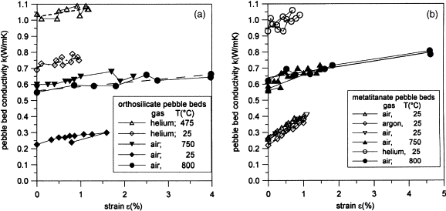
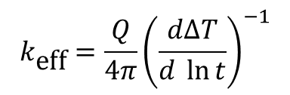
Effective thermal conductivity - ceramic
Pulse of current
$$k_{\text{eff}}=\frac{Q}{4π}{\left(\frac{dΔT}{d \ln{t}}\right)}^{−1}$$
Thermocouples
Li₄SiO₄
Li₂TiO₃

Slide 17
Creep properties of ceramic pebble beds
m
e
t
a
t
i
t
a
n
a
t
e
p
e
b
b
l
e
b
e
d
s
3
T
=
7
5
0
°
C
T
s
d
g
s
(
°
m
C
)
(
%
)
(
m
)
T
i
-
B
:
9
5
0
8
7
0
.
5
-
1
T
i
-
D
:
1
0
4
0
9
2
1
-
2
T
i
-
D
l
t
a
:
"
"
2
5
2
T
i
-
A
:
1
0
5
0
9
5
1
.
5
-
2
.
5
Creep Strain [%]
T
i
-
E
:
1
1
0
0
8
6
1
-
5
T
i
-
G
:
1
1
0
0
8
9
1
-
5
T
i
-
H
:
1
1
0
0
9
1
1
-
3
T
i
-
F
:
1
1
4
0
9
0
2
-
7
T
i
-
I
:
1
2
0
0
9
2
1
0
-
5
0
1
T
i
-
J
:
1
2
0
0
8
4
1
-
3
T
i
-
K
:
1
2
0
0
8
3
1
-
3
Granular
material
e_{cr}(t) = A exp(-B/T(K)) s(MPa)^{p} t(s)^{n}
100
1000
10000
Creep Time [min]
A
B
p
n
FZK-Li₄SiO₄
12.12
10220
0.65
0.2
CEA-Li₂TiO₃
0.67
7576
0.65
0.18
JAERI-Li₂TiO₃
0.37
6947
0.65
0.19

Slide 18
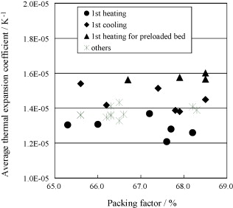
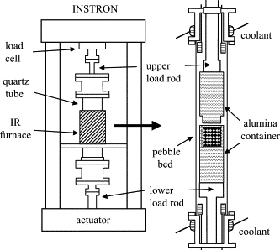
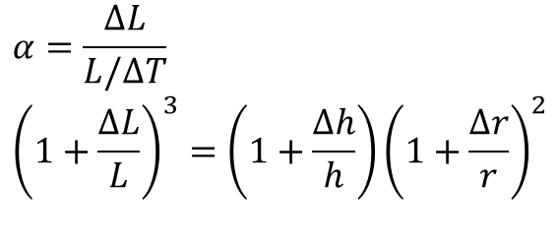
Effective thermal expansion
Li₂TiO₃
$$α=\frac{ΔL}{L/ΔT} \\ {\left(1+\frac{ΔL}{L}\right)}^{3}=\left(1+\frac{Δh}{h}\right){\left(1+\frac{Δr}{r}\right)}^{2}$$
10x higher than bulk material

Slide 19
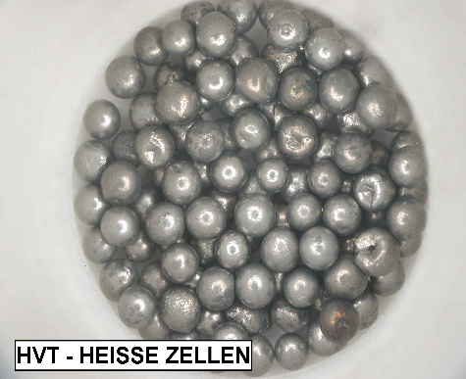
Effective properties - Beryllium
Be Pebbles after compression
HECOP
Steady-state method
Application of Hot Wire Method

Slide 20
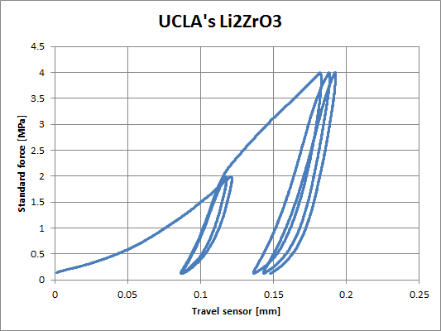
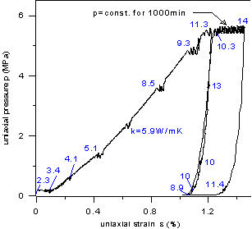
Demonstrating effective conductivity, modulus, plastic rearrangement
Beryllium
(k = 200 W/mK)

Slide 21
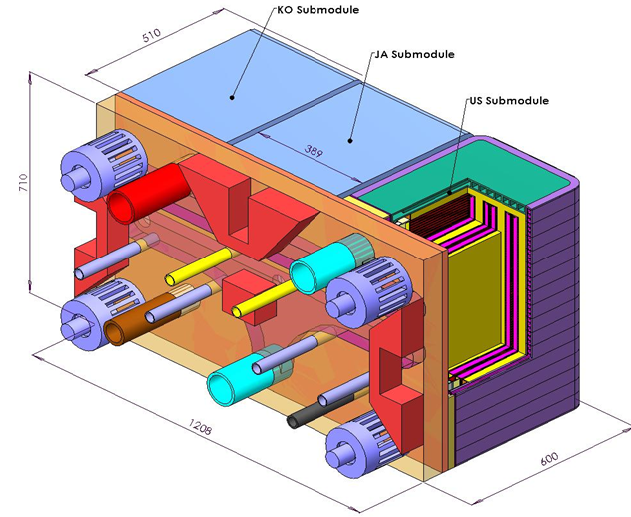
Continuum material treatment of pebble bed

Slide 22
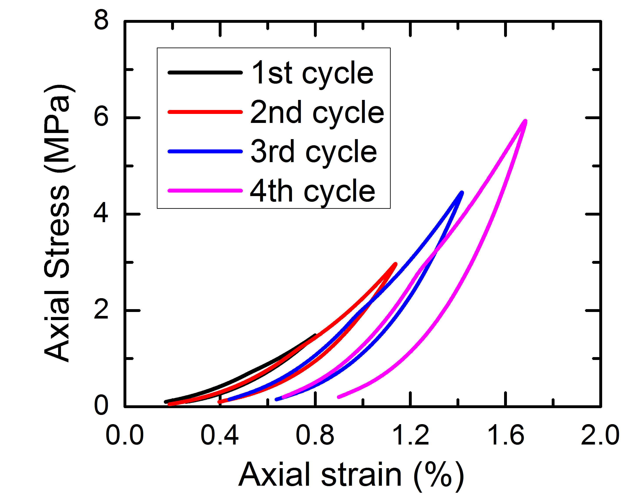
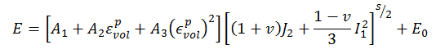
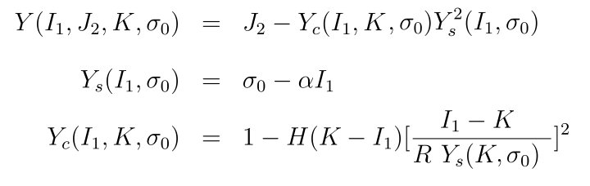
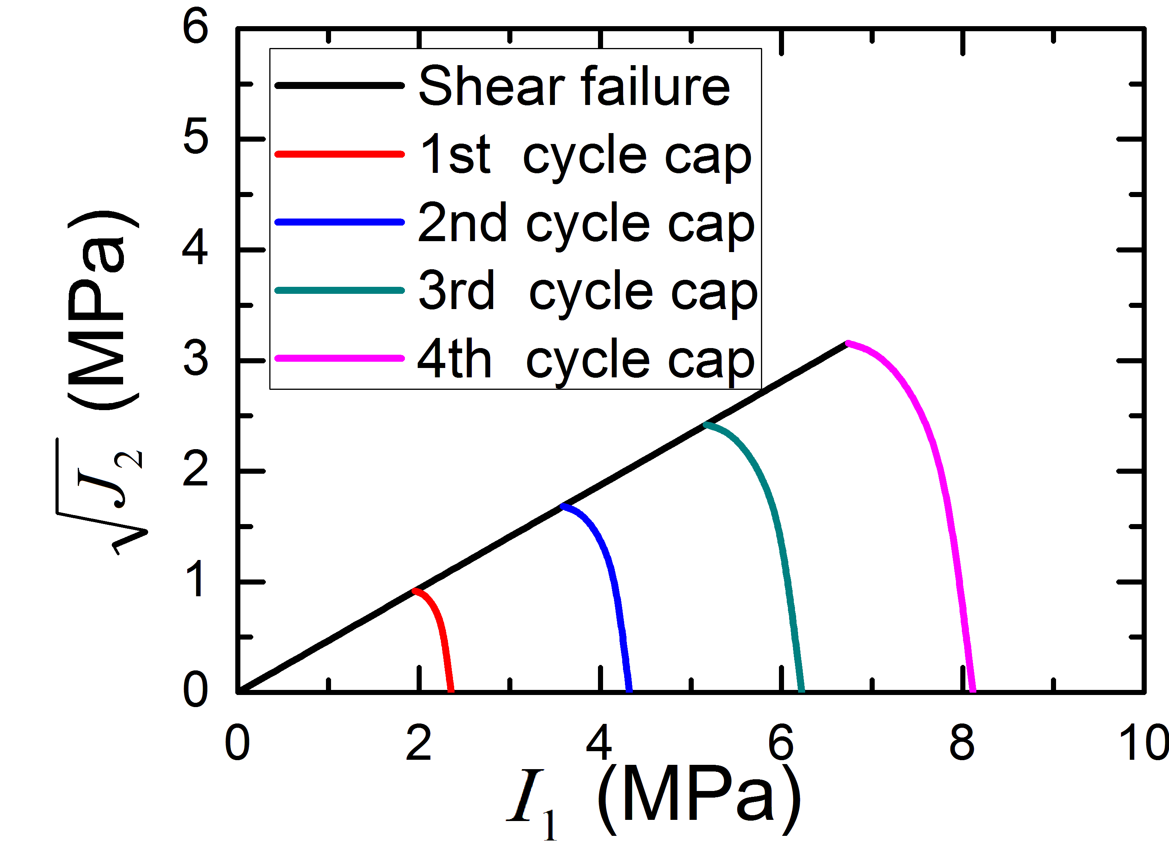
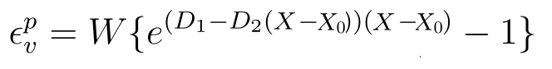
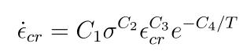
UCLA’s “unified cap” implementation of FEM
Example curves
A₁₋₃, s, E₀ are empirically derived T-dependent constants
R, K₀, σ₀, and α are empirically derived constants
W, D₁, D₂, and X₀ are empirically derived constants
C₁, C₂, C₃, and C₄ are empirically derived constants
Features:
1) A unified yielding surface for both cap and shear portions;
2) Strain-dependent creep law better reflecting the localized creep behavior of pebble bed.

Slide 23




Temperature distribution (ºC)
Stress/strain during loading and unloading
Plastic strain distribution along the Y-direction
Stress distribution along the Y-direction (Pa)

Slide 24
FEM coupling with DEM
Finite element treatment of pebble beds can give advanced understanding of interaction at the outset
Gap formation from settling and pebble damage still a major issue
Can FEM simulations integrate with DEM to intermittently provide new packing formations?
FEM-derived pebble bed volume after compaction
g
DEM predicts the pebbles to settle and fill the gap
Gap poorly handled in FEM
Containing structure

Slide 25

Closing remarks for thermomechanics
Good…
Non-mobile breeder avoids many of the problems associated with liquid breeders
Pressure drop
Corrosion
Large external inventory of lithium
Not so good…
Low thermal conductivity of ceramic
Decreased further in pebble form
Decreased yet again under irradiation
Bound by a temperature window
$T_{\text{min}}$ for bulk diffusion of tritium in ceramic
$T_{\text{m}\text{ax}}$ to avoid sintering
Low k and temperature window combine to limit power density and potentially achievable TBR

Slide 26



Advanced material investigations
Ceramic foam
Sharafat, S., Ghoniem, N., Sawan, M. E., Ying, A., & Williams, B. (2006)
Spark-plasma Sintering
Grains on the outside of a pebble before sintering
Grains on a pebble after spark plasma sintering

